Slide 1
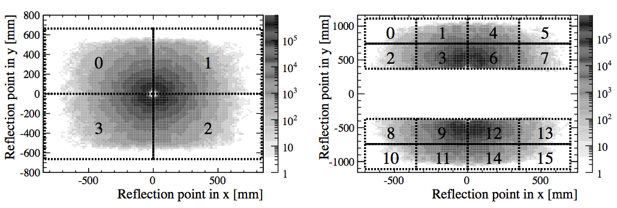
Primary mirrors
Secondary mirrors

Slide 2
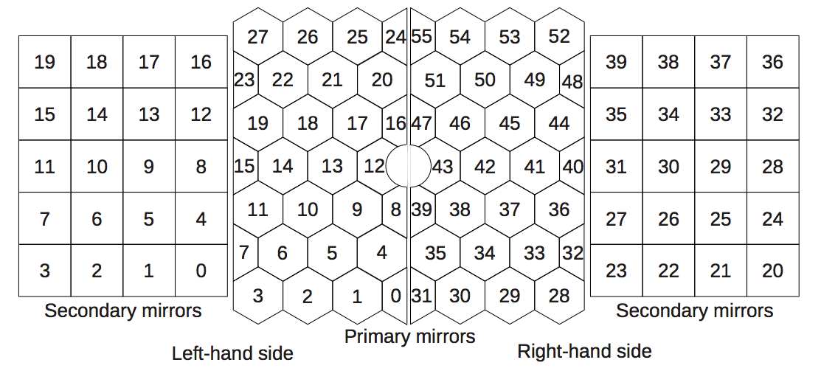

Slide 3
